Slide 1
UML
Use case diagrams

Slide 2
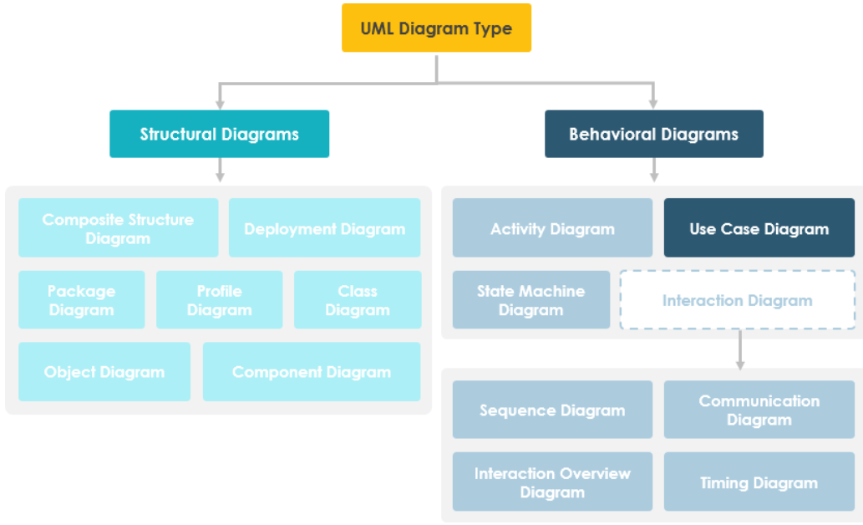
Notes:
Use cases represent only the functional requirements of a system. Other requirements such as business rules, quality of service requirements, and implementation constraints must be represented separately, again, with other UML diagrams.

Slide 3
Use case Diagrams
Describe a set of actions (use cases) that some system or systems (subject) should or can perform in collaboration with one or more external users of the system (actors).
UML 2.0 to 2.4 specifications also described use case diagram as a specialization of a class diagram
So, they are also structure diagrams - as a special case of class diagrams where classifiers are restricted to be either actors or use cases related to each other with associations.

Slide 4
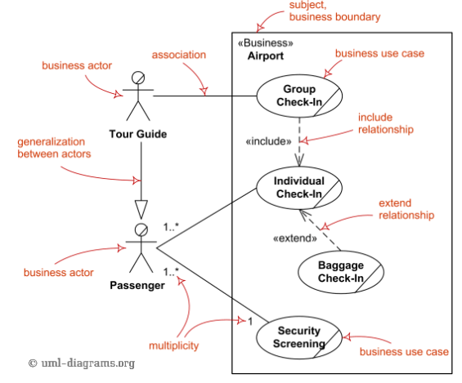
Business Use Case Diagrams
Business use cases were introduced in Rational Unified Process (RUP) to represent business function, process, or activity performed in the modeled business

Slide 5
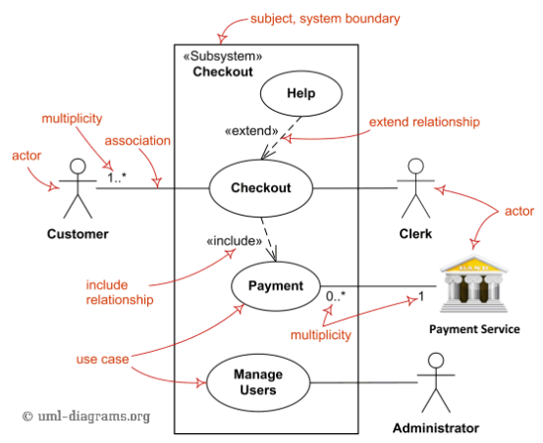
System Use Case Diagrams
(System) Use case diagrams are used to specify:
(external) requirements, required usages of a system under design or analysis (subject) - to capture what the system is supposed to do;
the functionality offered by a subject – what the system can do;
requirements the specified subject poses on its environment - by defining how environment should interact with the subject so that it will be able to perform its services.

Slide 6
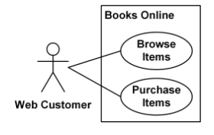
Use Case Subject
A subject is a classifier (including subsystem, component, or even class) representing a business, software system, physical system or device under analysis, design, or consideration, having some behavior, and to which a set of use cases applies.
A subject of a use case defines and represents boundaries
Notation: presented by a rectangle with subject's name, associated keywords and stereotypes in the top left corner
Books Online (subject) with applicable use cases and Web Customer actor.

Slide 7
Business Model Subject
In the context of business modeling, use cases are used to model various business entities.
These entities can include business, enterprise, company, or its divisions, departments, and teams.
For example, consider a Department Store, an Airport, or a Restaurant as potential business subjects.
To represent business subjects in UML, custom stereotypes like «Business» or «Department» can be used.
Let's take the example of a «Business» Restaurant, which can have business actors like Customer, Advertiser, and Supplier.

Slide 8
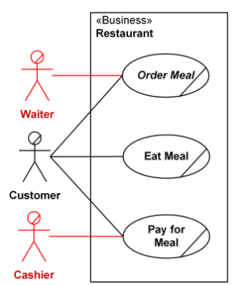
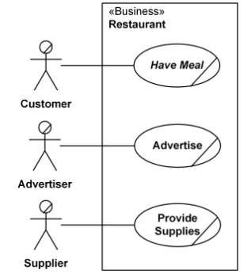
Business Model Subject
Mistake: Restaurant business should not have Waiter and Cashier as actors
Restaurant business subject with business actors and applicable use cases

Slide 9
Software System Subject
In the context of software systems, use cases describe how a system automates business processes.
Subjects can include software and/or hardware systems, subsystems, components, or devices.
Examples of software systems include a Web Site, a Payment System, an Automated Teller Machine (ATM), or a Point of Sale (POS) Terminal.
In UML for software systems, following stereotypes are often used for clarity.
«Subsystem»,
«Process»,
«Service»,
«Component»

Slide 10
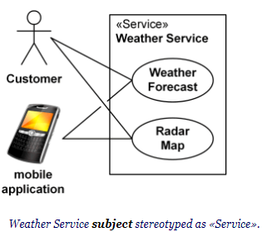
Software System Subject
For instance, a "Weather Service" can be stereotyped as «Service», representing a software service
The use cases for this subject might include "Retrieve Weather Data," "Provide Weather Forecast," and "Alert Weather Warnings."

Slide 11
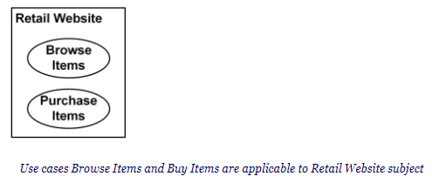
Applicability of Use Cases
Use cases located within system boundaries are applicable to the subject, but they are not necessarily owned by the subject.
For example, use cases like "Browse Items" and "Buy Items" are applicable to a Retail Website subject, which represents the system.
It's possible for some use cases to be applicable to multiple subjects, depending on the interactions and dependencies.

Slide 12
Ownership of Use Cases
In UML, a subject can own (or nest) some or all of the applicable use cases.
Use cases owned by a subject are represented using the standard notation for nested classifiers.
For instance, a "Retail Website" subject may own use cases like "Manage User Accounts" and "Process Orders," which are critical for the functionality of the system.

Slide 13
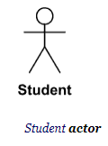
UML Actors
Actors in UML represent external entities that interact with a system.
UML actors specify roles played by external entities interacting with the system.
These can include human users, other systems, or hardware devices.
Examples of actor names (user roles): Customer, Web Client, Student, Passenger, Payment System
Standard UML notation for actors is the "stick man" icon with the actor's name above or below

Slide 14
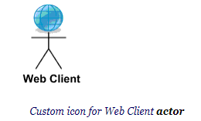
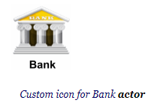
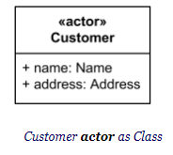
UML Actors
An actor can only have binary associations to use cases, components, and classes.

Slide 15
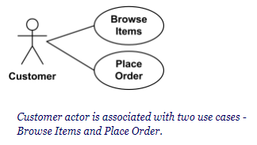
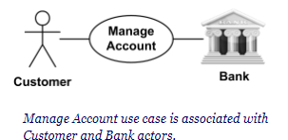
Association Between Actor and Use Case
An actor could be associated to one or several use cases.
A use case may have one or several associated actors.

Slide 16
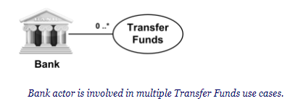
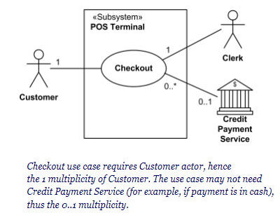
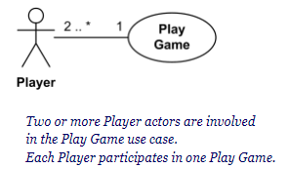
Multiplicity of Association Ends
use case multiplicity could mean that an actor interacts with multiple use cases:
in parallel (concurrently), or
at different points in time (overlapping), or
mutually exclusive (sequentially, random, etc).

Slide 17
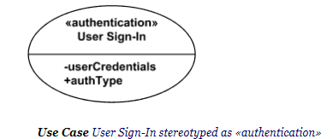
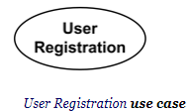
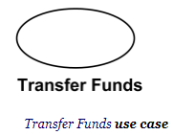
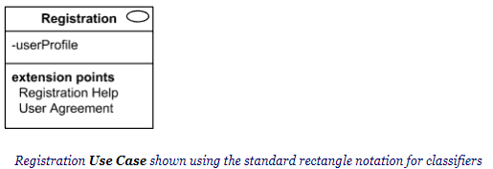
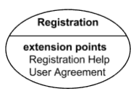
UML Use Case
A use case is a kind of behaviored classifier that specifies a [complete] unit of [useful] functionality performed by [one or more] subjects to which the use case applies in collaboration with one or more actors, and which [for complete use cases] yields an observable result that is of some value to those actors [or other stakeholders] of each subject.
Use case is usually shown as an ellipse containing the name of the use case

Slide 18
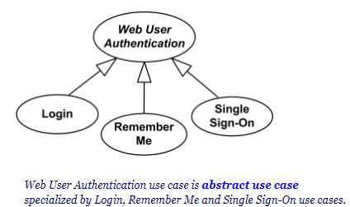
Relationships Between Use Cases
Generalization is shown as a solid directed line with a large hollow triangle arrowhead
Use cases could be organized using following relationships:
generalization
association
extend
include
Two use cases specifying the same subject cannot be associated since each of them individually describes a complete usage of the system.
Use cases can only be involved in binary associations.

Slide 19
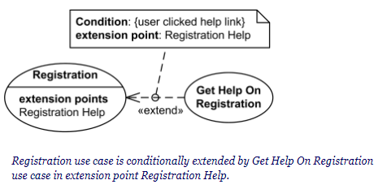
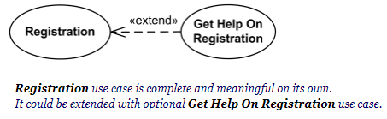
Use Case Extend
The "extend" relationship allows you to define additional functionality that is not always a part of the base use case.
It represents an extended or alternative flow of events that can occur under certain conditions
Extend relationship is shown as a dashed line with an open arrowhead directed from the extending use case to the extended (base) use case. The arrow is labeled with the keyword «extend».

Slide 20
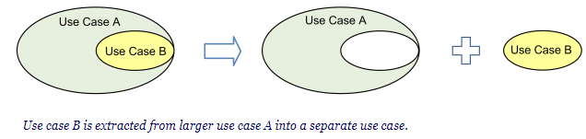
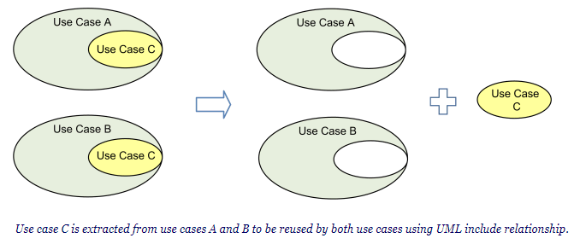
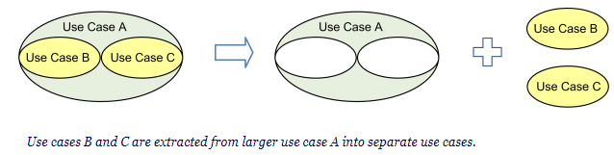
Use Case Include
Use case include is a directed relationship between two use cases which is used to show that behavior of the included use case (the addition) is inserted into the behavior of the including (the base) use case.
The include relationship could be used:
to simplify large use case by splitting it into several use cases,
to extract common parts of the behaviors of two or more use cases.

Slide 21
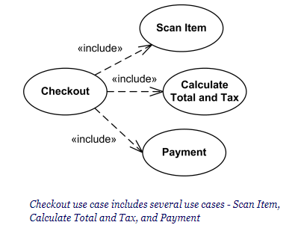
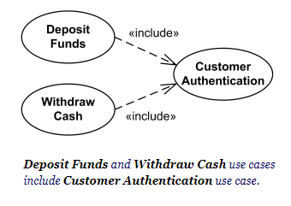
Use Case Include
Include relationship between use cases is shown by a dashed arrow with an open arrowhead from the including (base) use case to the included (common part) use case. The arrow is labeled with the keyword «include».

Slide 22
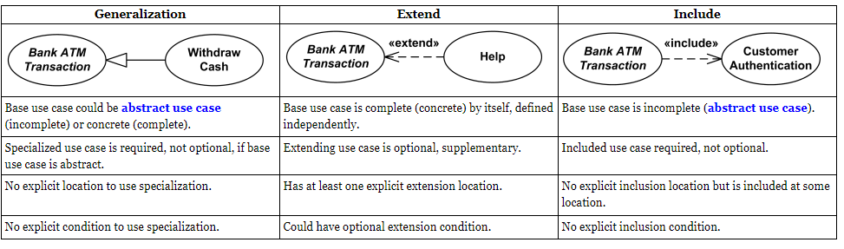
Use Case Relationships Compared

Slide 23


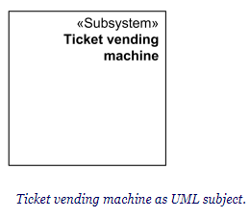
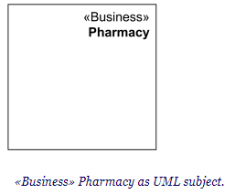
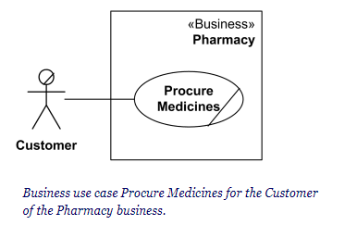
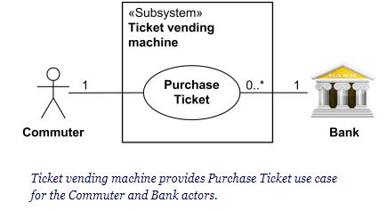
How to draw?
Define Subject
Define Actors
Define Use Cases

Slide 24
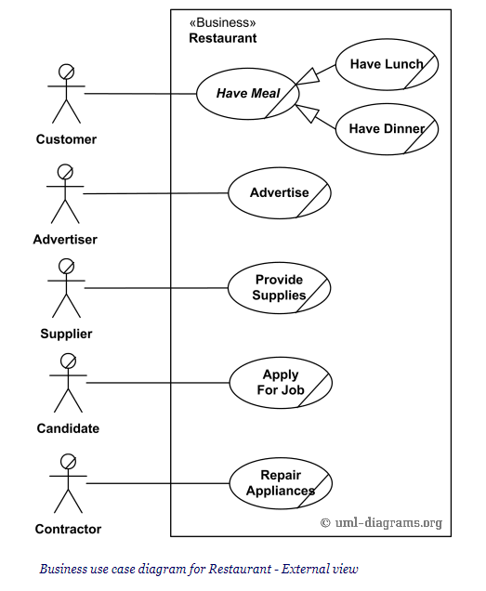
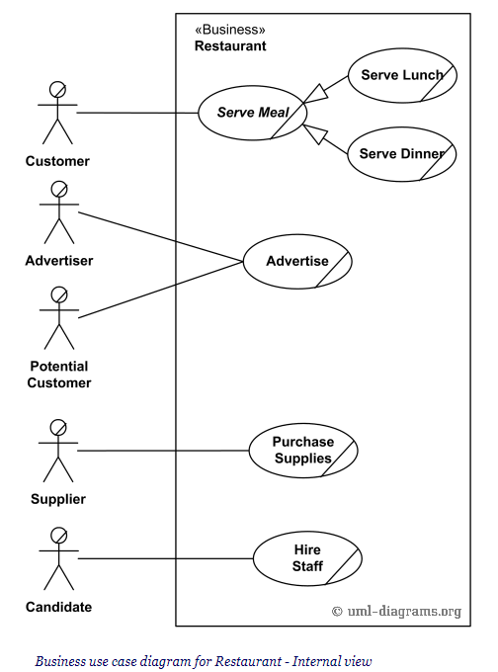
Use Case Diagram Examples: Restaurant

Slide 25
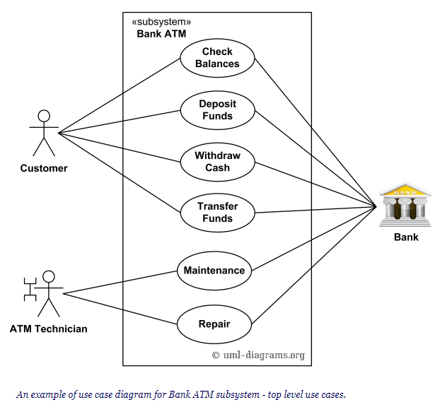
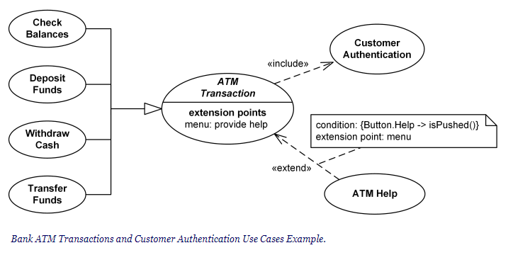
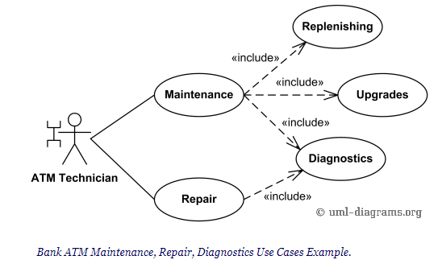
Use Case Diagram Examples: Bank ATM

